Slide 1
Big Data, AI, Machine Learning, Investment and Algo Trading
Ken Liu

Slide 2
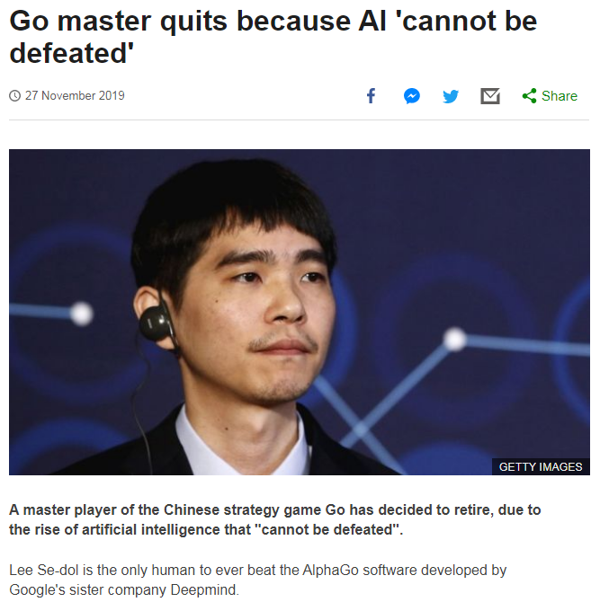
AlphaGo

Slide 3
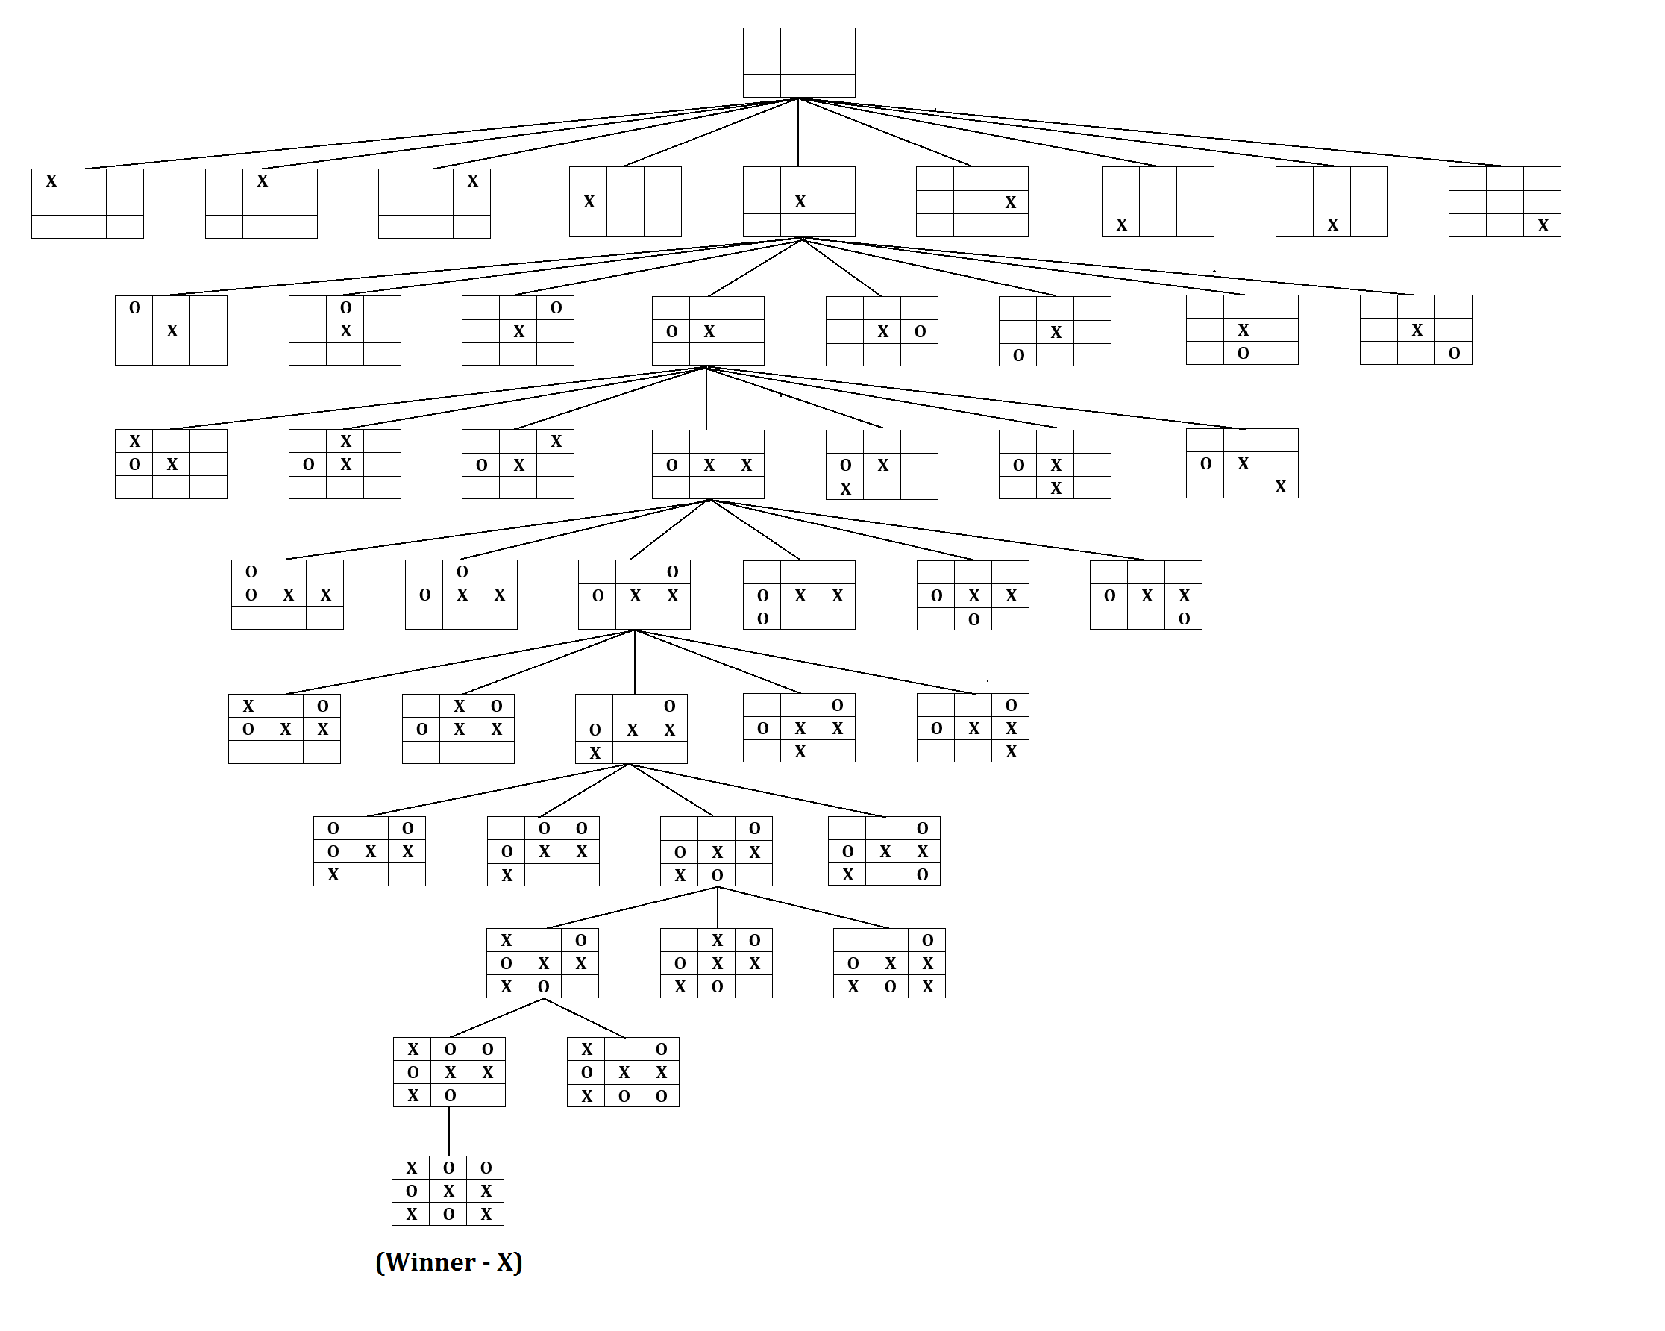
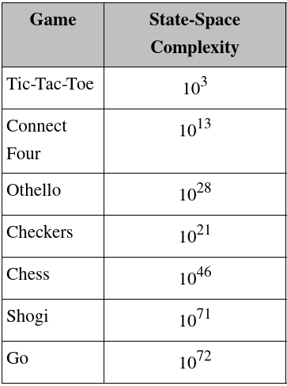
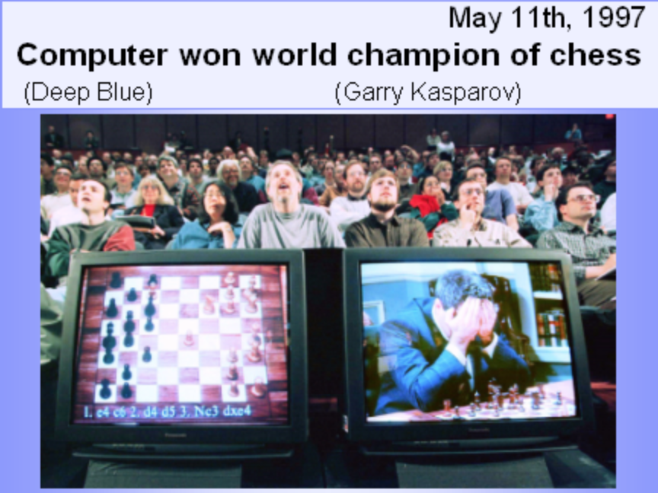
Traditional AI Approach
Game Search Tree

Slide 4
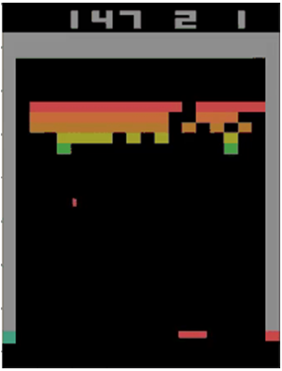
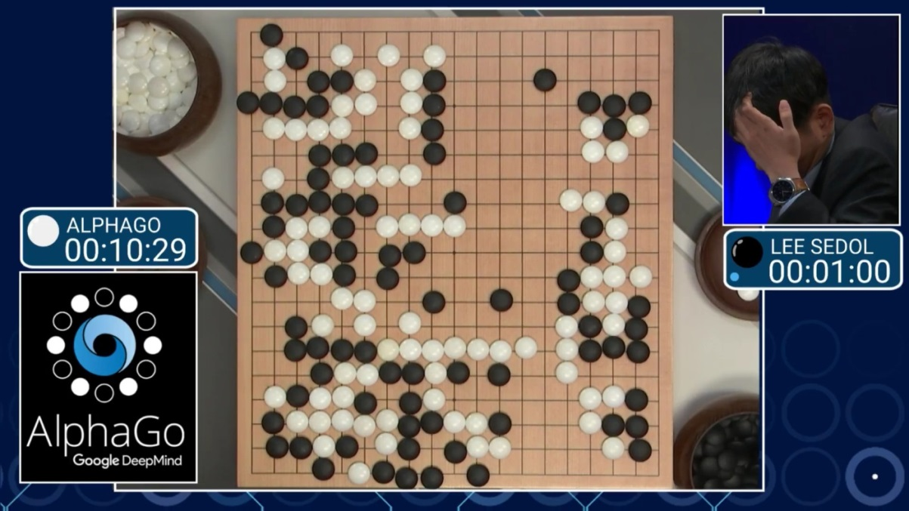
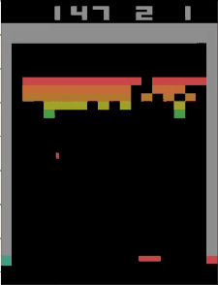
Reinforcement Learning
https://cs.stanford.edu/people/karpathy/convnetjs/demo/rldemo.html
Tunneling !

Slide 5

Reinforcement Learning
Software agents to take actions in an environment so as to maximize some notion of cumulative reward to achieve the objective.
The feedback (rewards or punishments) can be delayed.
Explore vs. Exploit: should the algorithm explore new alternative actions that may maximize the final reward, or stick to the established one that maximizes the immediate reward.

Slide 6
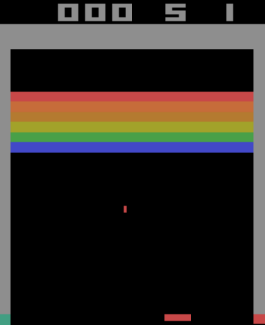
Reinforcement Learning
State | Action | Reward
 | Left | Score: 100, Life: 5
 | Right | Score: 101, Life: 5
 | Stay | Score: 101, Life: 4
….. | … | …
….. | … | …
….. | … | …
Like chess, in theory, we can list all the possible states (every pixel combinations), actions and rewards. Then choose the sequence of the actions that leads to the best rewards.
What are the draw backs?
Require large storage to store the tables and computing time to evaluate the steps
Very time-consuming to prepare such dataset
Not all states are valid

Slide 7
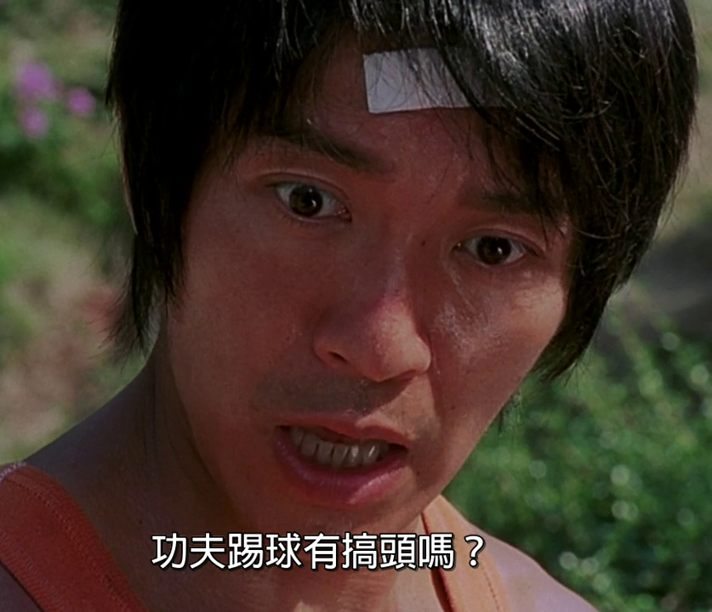
Deep Learning + Reinforcement Learning
Deep Learning +
Reinforcement Learning
Kung Fu + Football = Good idea

Slide 8
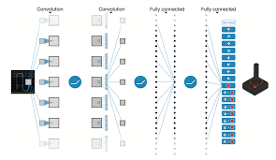
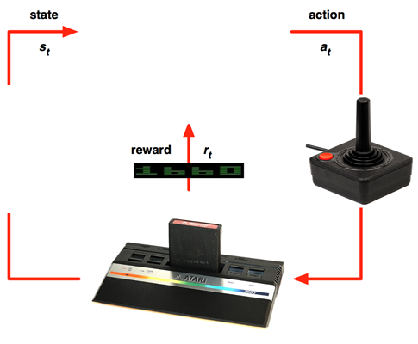
Deep Reinforcement Learning
Just play the game and record each frame (state) and action as the input and the corresponding reward as the output
Each frame is just an image and hence train CNN (Convolutional Neural Network) to approximate the input images (states and actions) to the output rewards relationships
Supervised Learning learns Relationship (Classification / Regression); RL learns Policy (Strategy)

Slide 9
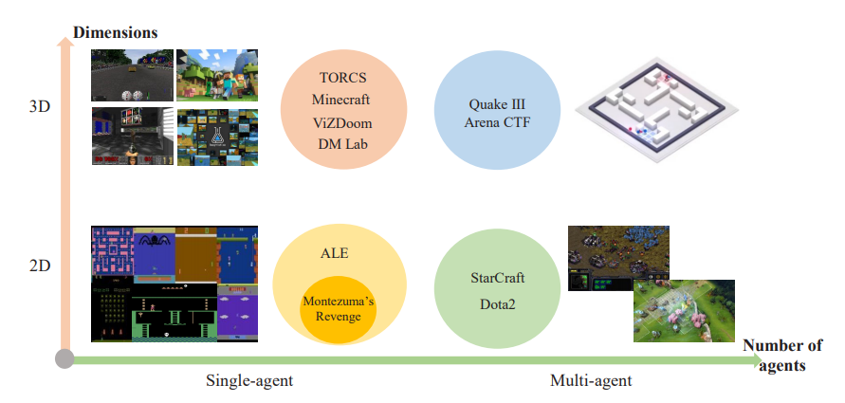
Deep Reinforcement Learning on Games
This method is very generic and can apply to many different games: Code Demo
Source: A Survey of Deep Reinforcement Learning in Video Games

Slide 10
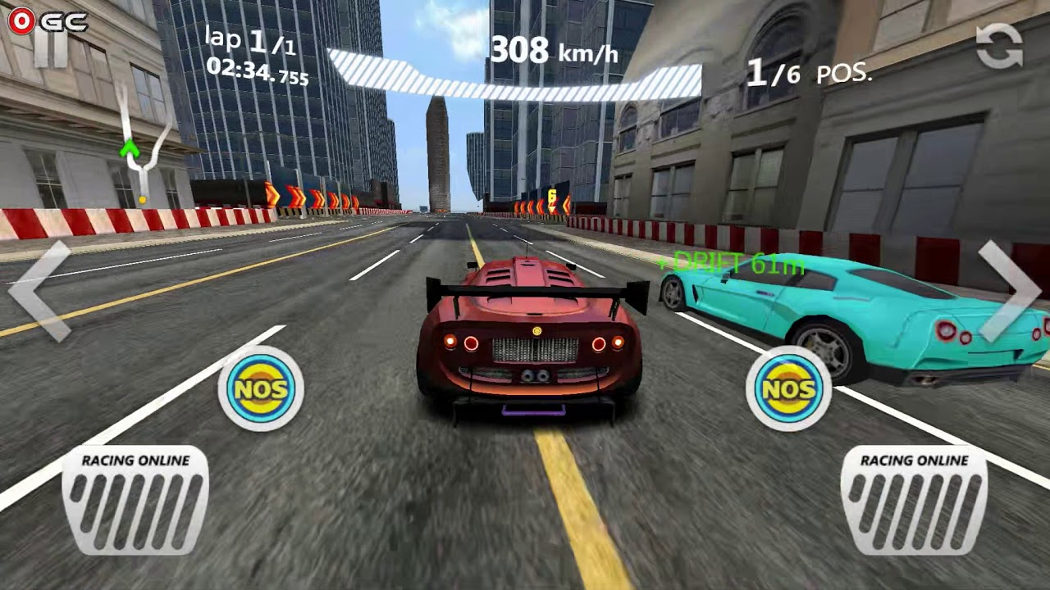
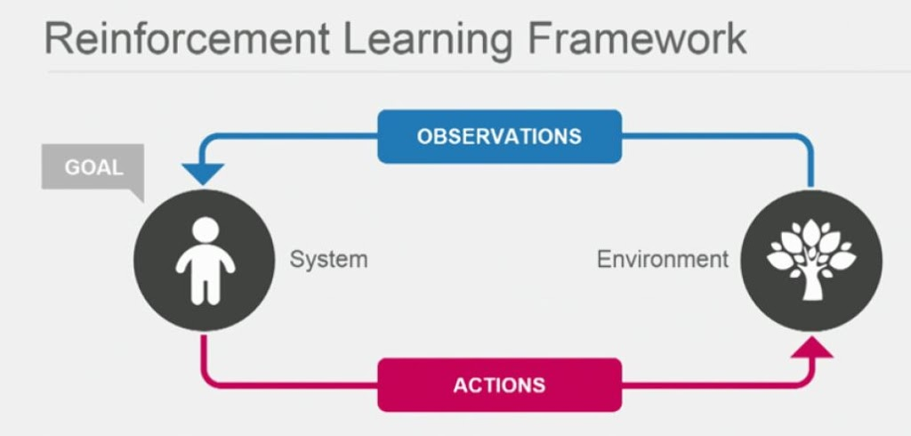
Deep Reinforcement Learning on Self-driving
Apply deep reinforcement learning similar to a car racing game

Slide 11
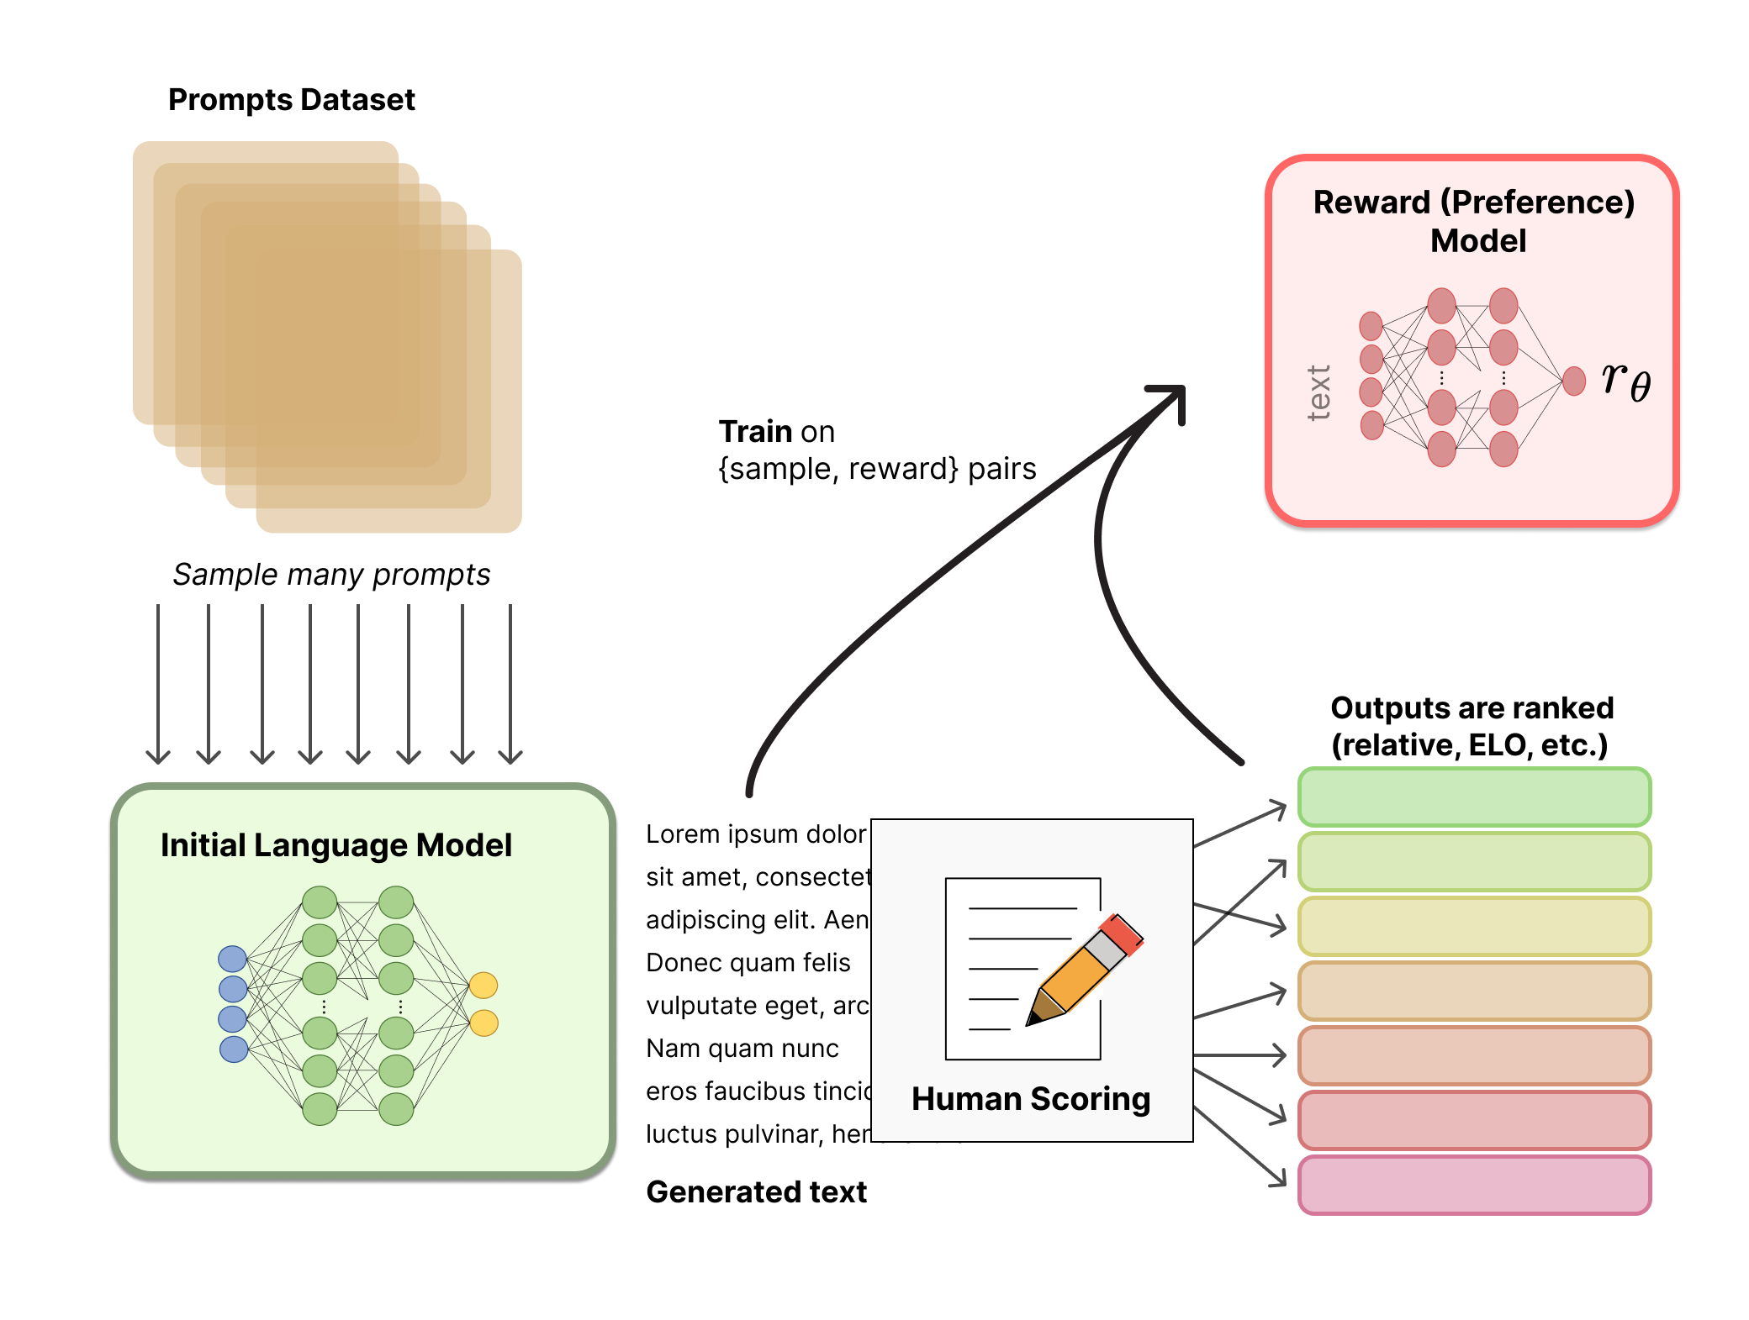
Deep Reinforcement Learning on ChatGPT
Reinforcement Learning from Human Feedback (RLHF)

Slide 12
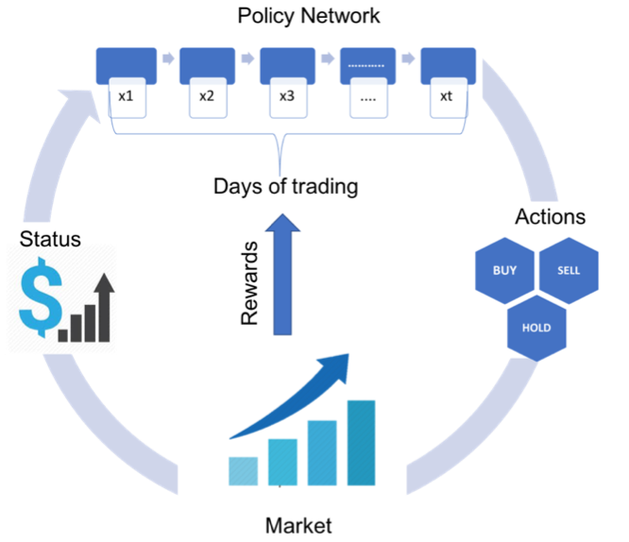
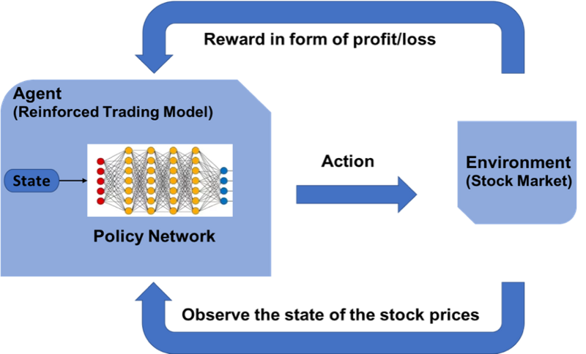
Deep Reinforcement Learning on Trading

Slide 13
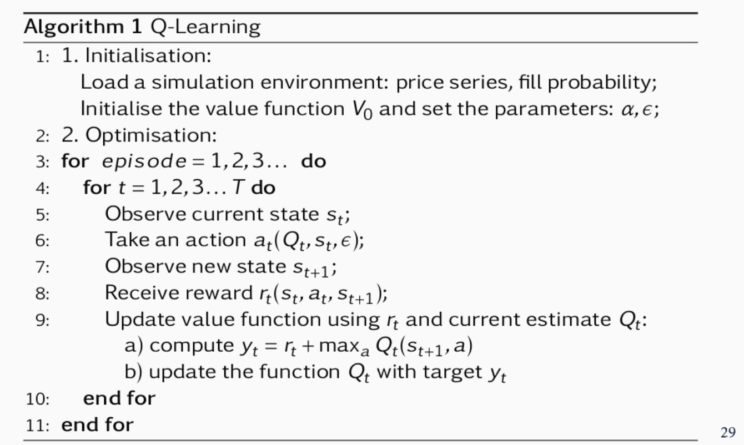
Deep Reinforcement Learning on Trading
JP Morgan LOXM
Learns to perform the best action (choose optimal price, duration and order size ) based on market conditions
State: price series, spread cost, fill probability, size placed, elapsed time, %progress
Rewards: immediate rewards (price spread) and terminal (end of episode) rewards like completion, order duration and market penalties (negative rewards that punish the agent)

Slide 14
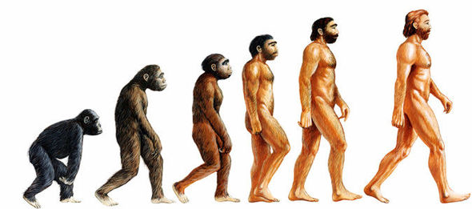
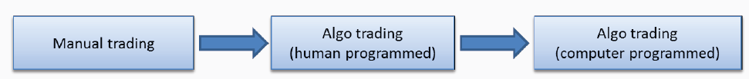
Deep Reinforcement Learning on Trading
AI Traders -> Repeatedly Doing Backtest -> Find the Optimal Strategies

Slide 15
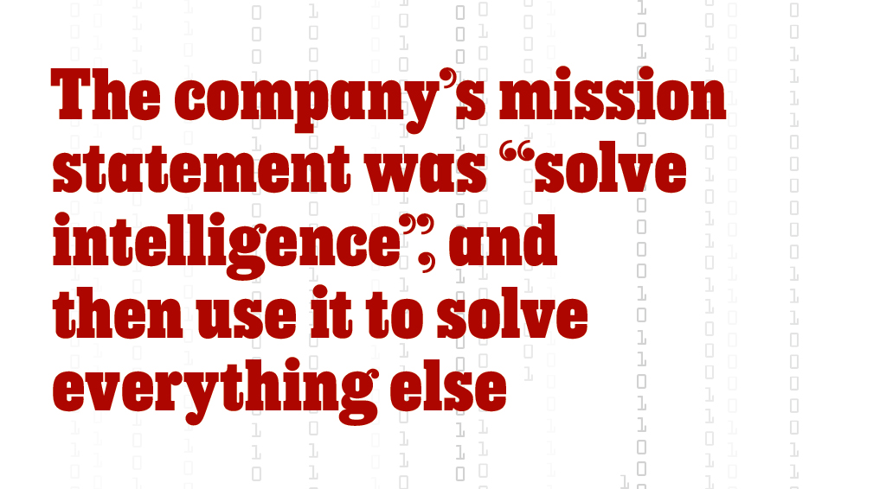
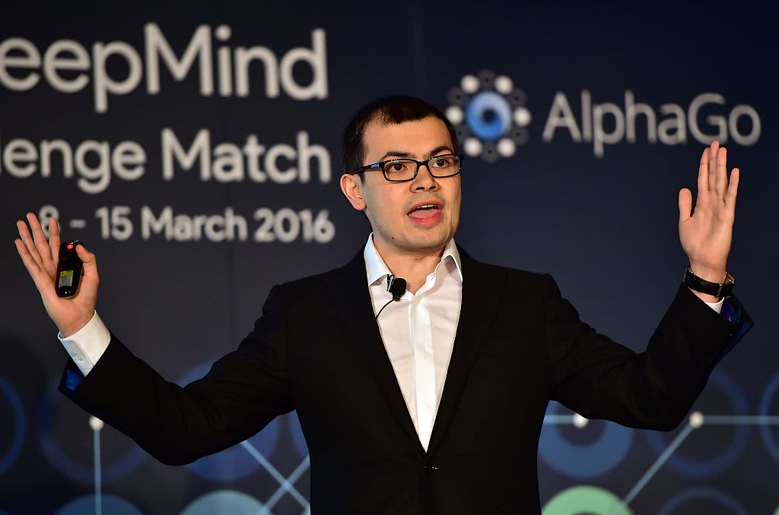
Deep Reinforcement Learning on Trading

Slide 16
Deep Reinforcement Learning on Trading
It is a very black box approach and may not be welcomed by compliance and regulators
HKMA : High-level Principles on Artificial Intelligence
Board and Senior Management accountable for the outcome of AI applications
Possessing sufficient expertise
Ensuring an appropriate level of explainability of AI applications
Using data of good quality
Conducting rigorous model validation
Ensuring auditability of AI applications
Being ethical, fair and transparent
Conducting periodic reviews and ongoing monitoring
Complying with data protection requirements
Implementing effective cybersecurity measures
Risk mitigation and contingency plan

Slide 17
Deep Reinforcement Learning on Trading
Control Sand box
Price < 2% + current last price
Quantity < best bid/ask size
Trading frequency < 30 orders per min

Slide 18
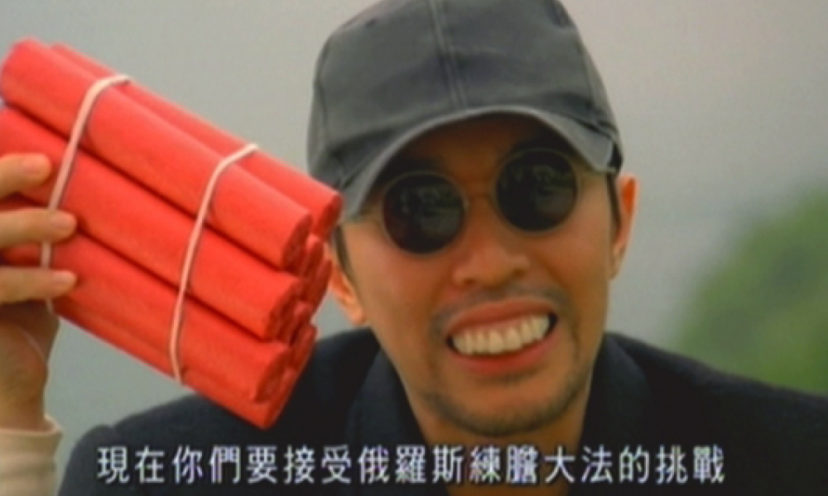
Challenges in Trading & Investment
Russian-style challenges

Slide 19
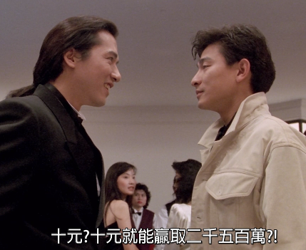
Challenges – Data Cost
Market data cost: used for model training and back testing. It is expensive to buy historical tick data. For example, HK stocks tick data is HK$5,000/month from HKEx. As a small startup, we only buy 6 months.
Data Hungry: Machine Learning models (especially Deep learning) requires a lot of data to discover meaningful signals
News, Sentiment and Alternative Date (Satellite Image, Credit Card transaction etc.) are too expensive and we cannot afford at all
Use $10 to win $25 millions ?

Slide 20
Challenges – Transaction Cost
Day trading has high number of transactions that amount to large commission fees that eats up the profile. To realize the profile, it involves buy/sell and hence needs to count the costs twice.
Explicit cost: Trading fees and commissions in HK Stock Transaction Costs
Brokerage Fee: 0.25% or min. HK$100 (negotiable and could be free)
Transaction Levy: 0.0027% of transaction amount
Trading Fee: 0.005% of the transaction amount
Stamp duty (collected for HKSAR Government): 0.1% of transaction
(HK Index Future HK$15 per mini-contract offered by Interactive Broker)
Implicit cost: Bid/Ask spread cost. Buy at offer (higher) and Sell at bid (lower)

Slide 21
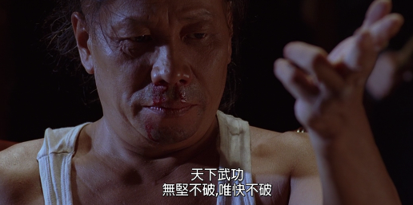
Challenges – Infrastructure Cost
Arbitrage strategy (e.g. warrant mis-pricing) requires ultra-low latency trading infrastructure
Real-time market data: a colo exchange market data feed caused ~HK$80K per month
Low latency trading infrastructure: fast order placement and cancellation
In kung fu, speed is most important

Slide 22
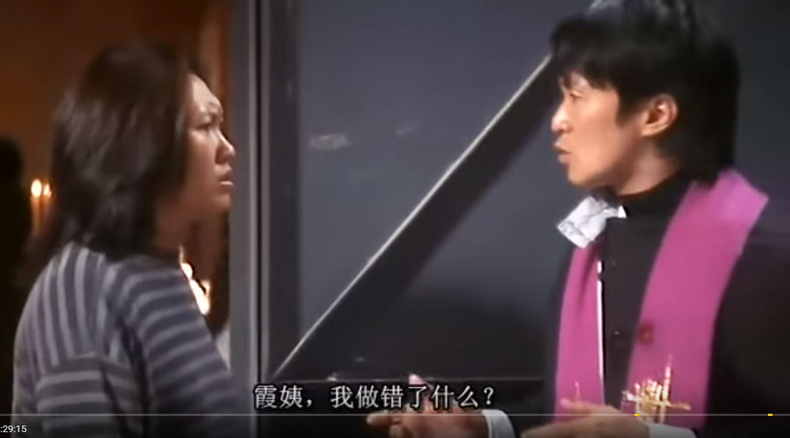
Challenges – Scale
Sometimes you don’t need a very sophisticated trading strategy, you just need to have scale (a dominant player)
Stealth on IPO stabilization trade
Market-on-Close on index rebalance order
Market Making on Warrants
黃子華 2006:
「冇錯，你係你呢套戲嘅主角，問題係，你呢套戲嘅戲名叫做《茄喱啡的一生》
Your trading strategy is insignificant comparing to the whole market
Auntie Ha, what did I do wrongly?

Slide 23
Challenges – Data Source
Face Recognition vs World Cup Prediction vs Weather Forecast
Compare Weather forecast to Stock Price forecast as both are time-series based
 | Weather | Stock Price
Seasonality | Yes, strong auto-correlation to due seasonal patterns | History repeat itself?
Regime Switching | Global Warming | Bull/Bear, Macroeconomics, technologies
Visibility | Can measure the temperature, humidity etc. | Cannot measure investors decisions
Causality | Temperature, air pressure, humidity etc. | Historical price, news, sentiment?

Slide 24
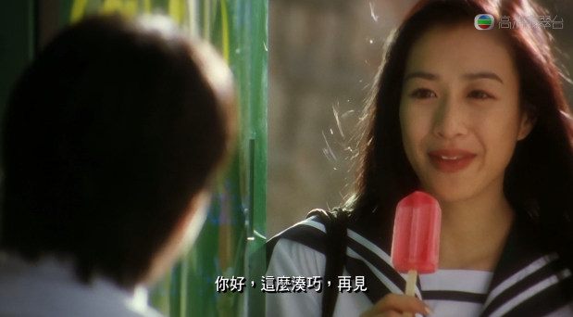
Challenges – Correlation vs Causality
Correlation vs Causality: correlation does not imply causation. If two stocks move in a correlated fashion, it doesn’t necessarily mean stock A causes the Stock B to move. It could both be under another common factor.
Example: HSBC and Bank of China is correlated (banking sector)
Scenario 1: Interest Rate rise
Scenario 2: Bank of China has a solid earning
Stephen Cucchiaro: “No scientist or engineer would ever use correlation analysis for analyzing a nonlinear complex system of interrelated variables,” he says, “because those correlations are often nothing more than statistical coincidences, not true cause-and-effect relationships.”
Hi, what a coincidence?

Slide 25
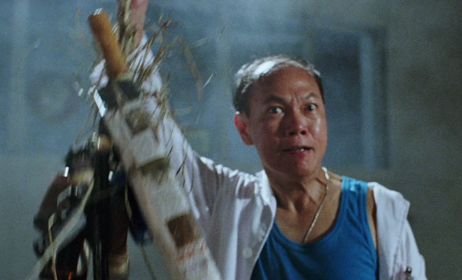
Challenges – Feature Engineering
Data and Features: spend 80% of (active) time to prepare the data and which is not too much fun (training models also needs time and but just let the computer run while going for lunch)
Weak Signals (features): financial data is traditionally with very low signal-to-noise
攞你命三千
Take your life 3000

Slide 26
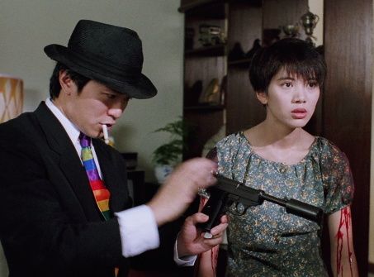
Challenges - Regime Switching
Stochastic (Randomness): confused supervised learning model. Is stock price a random walk or we need more features (factors) to train the model
Prediction timeframe: longer term subjects to (multiple) regime switching. Shorter term is more accurate, but is less profitable due to the transaction costs to realize the profile.
蠱惑的槍
Tricky Gun

Slide 27
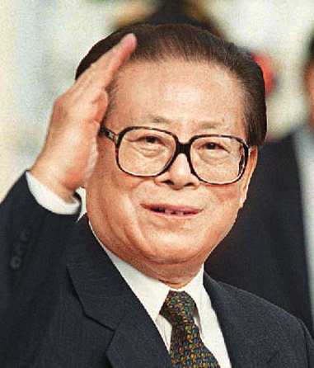
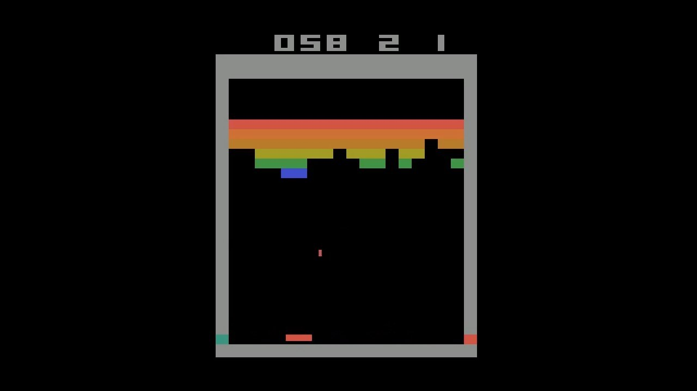

Challenges – Complexities
Overly simplified : our Reinforcement Learning strategies are too simple
Too simple sometimes naive
Our Model
JP Morgan LOXM

Slide 28
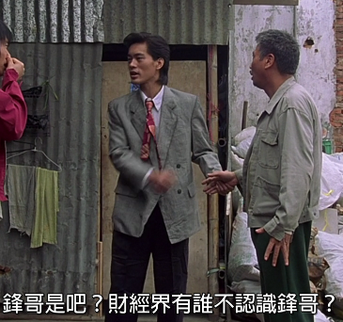
Challenges – Domain Knowledge
Expertise: 3 tech guys startup which lack trading experience and in-depth market insights
Financial products: financial instruments (especially derivative products) are linked or correlated in a complex fashion that adds volatility or uncertainties
“Fung Gor” is very famous in financial industry

Slide 29
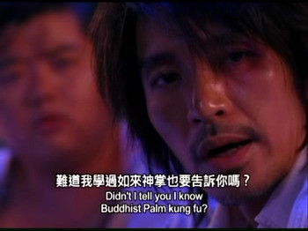
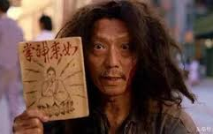
Challenges – Secrecy
Confidential: unlike software, no open source profitable strategies. Successful strategies are kept secretly.
Research papers are usually proof of concepts.

Slide 30
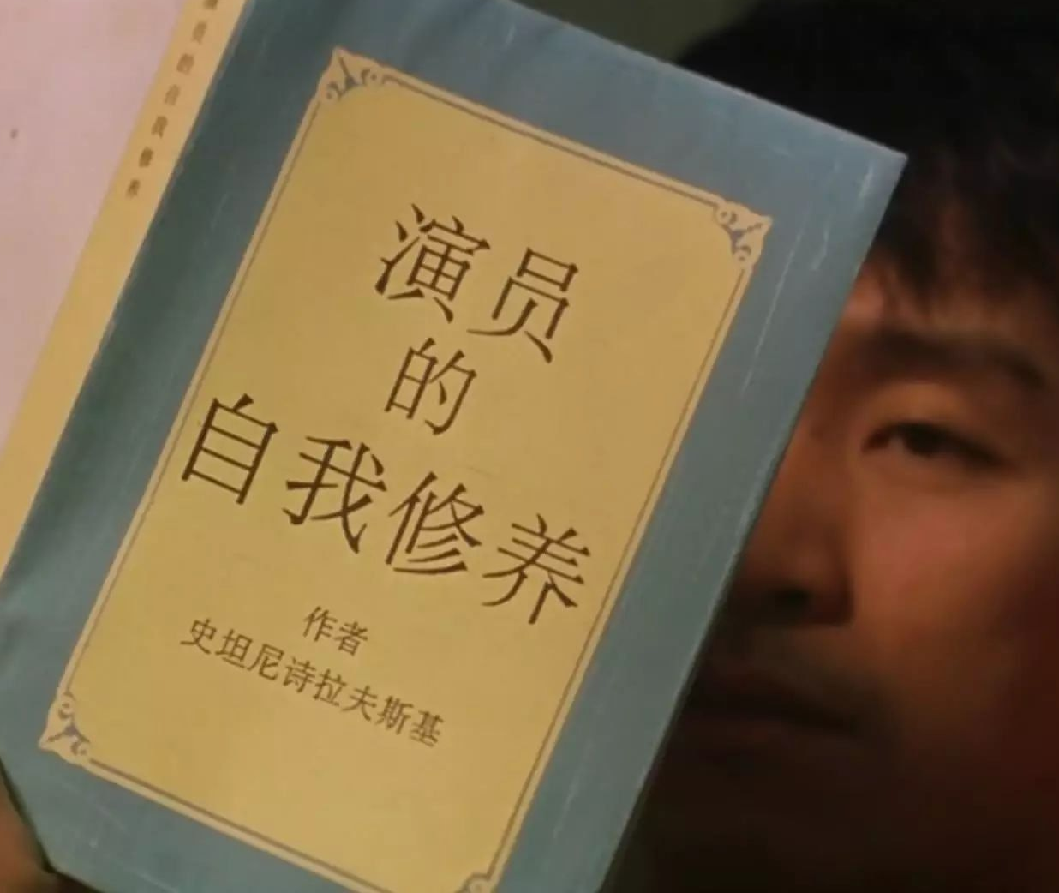
Challenges - Psychological
Mental Pressure: develop a profitable trading strategy is an all-or-nothing exercise and which create pressure
Self-Discipline: rush to have actions in the market and deploy strategies that are not fully back-tested

Slide 31
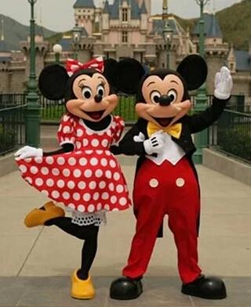
Challenges - Psychological
Excessive trading: Why doing full-time trading? Why don’t I just invest in Bitcoin, Tencent and NVIDIA
Social Value: Constantly question the meaning of our work as we’re not contributing to the society positively (e.g. making people happy)
Sour Grapes: to take on a negative attitude because you cannot have what you want 吃不到的葡萄是酸的

Slide 32
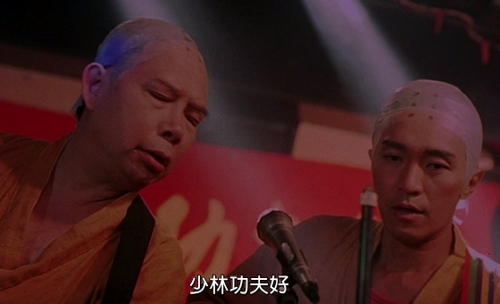
Challenges – False Belief
Maslow’s Hammer: Deep Learning is cool and let’s just apply it to trading
Machine learning 醒, Machine learning 好勁 佢用deep learning, deep learning 我用 Alpha Go, go go go…

Slide 33
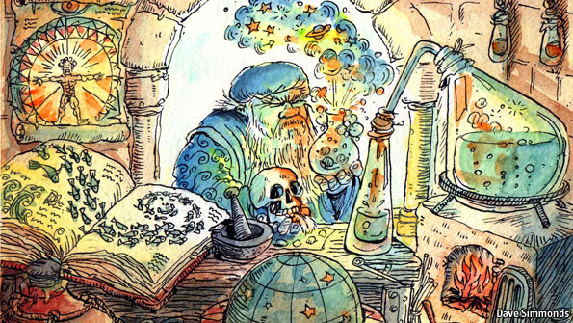
Challenges - Summary
Thought AI is Modem Alchemy (煉金術), put something (data) there and then pray it works.

Slide 34
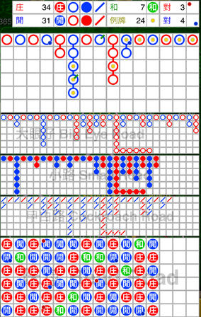
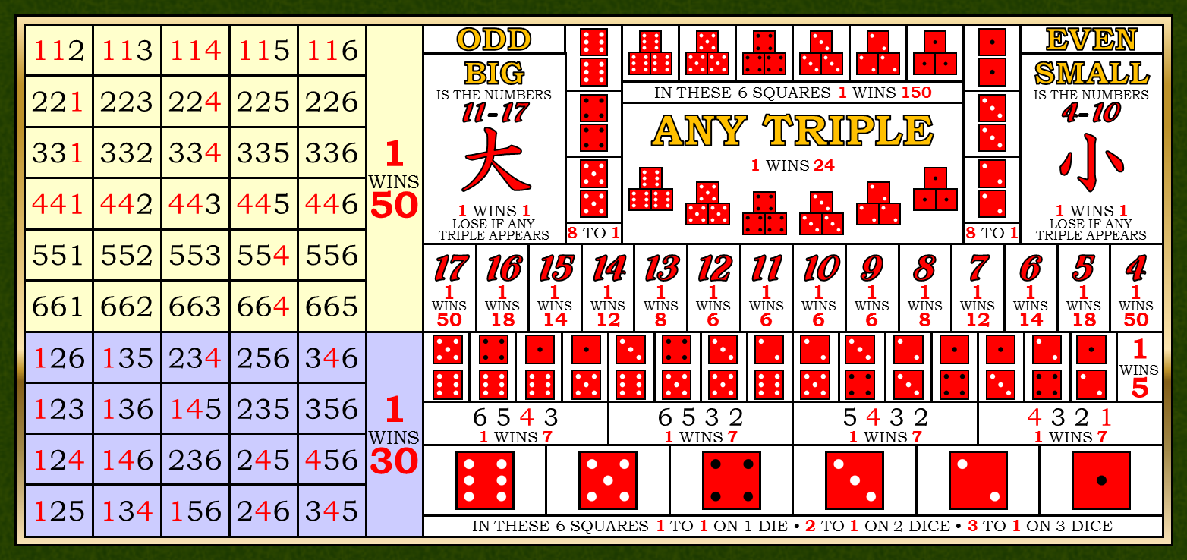
Thoughts and Discussions
Historical data useful?
After 4 consecutive rounds of “Big”, the next round is more likely to be
Big
Small
50/50
Trend Following (Momentum)
Mean Reversion
Each event is random and independent

Slide 35
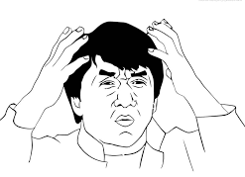
Thoughts and Discussions
In probability and statistics, each roll dice event is random and independent. So “50/50” seems a right choice.
In probability and statistics, the law of large numbers states that as a sample size grows, its mean gets closer to the average of the whole population.
Does it imply Mean Reversion?
阿媽, 我好亂呀 Mum, I’m so confused

Slide 36
Professor / Academia Thoughts
How about Stock Market? After 4 consecutive days of “Up”, the next day is more likely to be Up/Down?
S&P500 Up/Down after 4 consecutive days of Up
Period | Trending (Up) | Reverse (Down)
2010-2017 | 47% | 54%
2000-2009 | 45% | 55%
1990-1999 | 50% | 50%
1957-1989 | 57% | 43%
S&P500 before 1990 (before the development of highly efficient and liquid derivatives markets) shows stronger trend-following tendencies, followed by stronger mean-reversion tendencies after 1990 - Gerhard Larcher, The Art of Quantitative Finance Vol.1, 2023

Slide 37
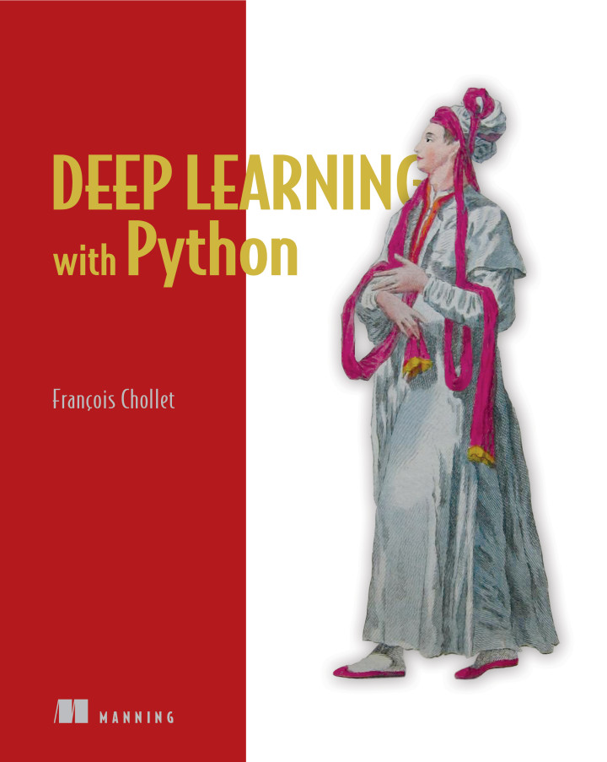
Scientist / Engineer Thoughts
Deep Learning with Python book p.224
Markets and Machine Learning
forecasting the future price of securities on the stock market (or currency exchange rates, and so on). Markets have very different statistical characteristics than natural phenomena such as weather patterns. Trying to use machine learning to beat markets, when you only have access to publicly available data, is a difficult endeavor, and you’re likely to waste your time and resources with nothing to show for it.
Always remember that when it comes to markets, past performance is not a good predictor of future returns —looking in the rear-view mirror is a bad way to drive. Machine learning, on the other hand, is applicable to datasets where the past is a good predictor of the future.

Slide 38
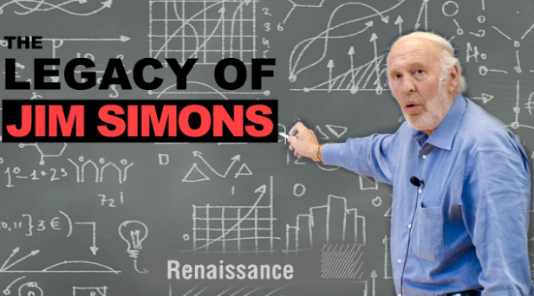
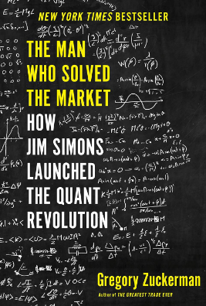
Mathematician / Industry Practitioner Thoughts
"Since 1988, his flagship Medallion fund has generated average annual returns of 66% before charging hefty investor fees—39% after fees—racking up trading gains of more than $100 billion.
— ‘The Man Who Solved the Market: How Jim Simons Launched the Quant Revolution’ by Gregory Zuckerman 2019

Slide 39

General People Thoughts
AI, 我不想努力了
AI, I don’t want to work hard anymore
Wrongly believe AI and trading will make a lot of money easily
Trading requires right features (domain knowledge and insights)
Pure AI and data-driven Algos trading will be hard!

Slide 40
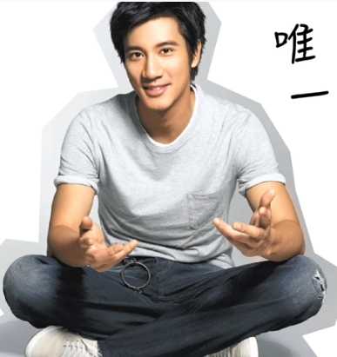
General People Thoughts
Wrongly believe you only need one trading strategy that can consistently predict stocks (or any asset) going up/down correctly and then forever make a lot of money
There are other things to model (volatility, regime switching, asset correlations / mispricing etc.)
Will need a lot of research, back-testing, fine-tuning and risk management (hedging / leverage)
Forever Love
Only One

Slide 41
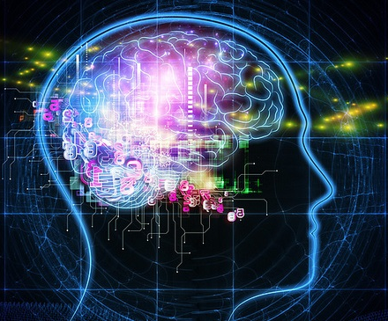
My Thoughts on Algo Trading and AI
AI in trading & investment are in early stage comparing to Image/Speech Recognition, Natural Language Processing
May not directly used in trading strategies but used it processing alternative data (satellite images, news sentiment)
Need to define a workable objective (not just predict price up/down). The objective could be just a sub-components of the overall strategy. For example, it can be the entry/exit signals for the alpha generating strategy

Slide 42

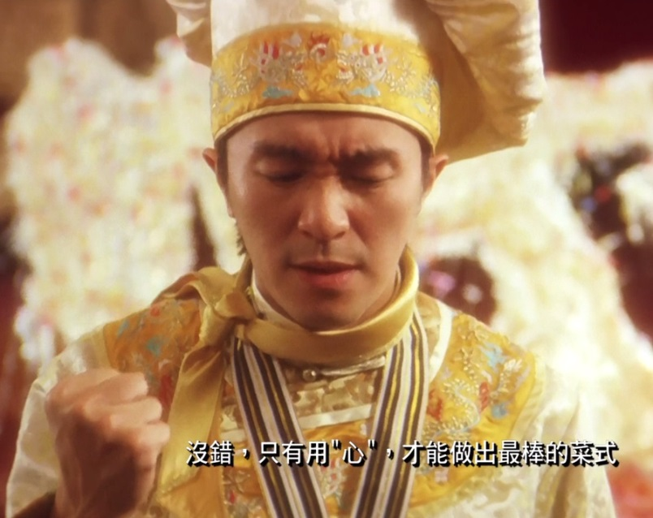
My Thoughts on Algo Trading and AI
More Ingredients: Sentiments, Satellite Images..
Better Tools: NLP, Deep/ Reinforcement Learning
Still needs (domain) knowledge, skills and experience

Slide 43
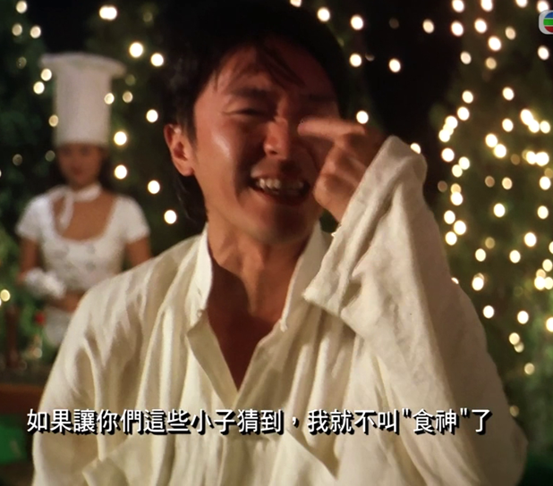
My Thoughts on Algo Trading and AI
If I’m so predictable, I’m not “God of Cookery”
So, it’s not easy !! That’s why I’m teaching here

Slide 44
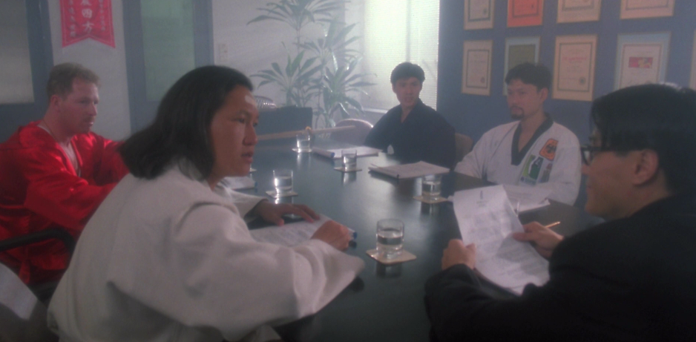
Limitation of Deep Learning
Linear Regression
XGBoost
SVM
Decision Tree
Deep Learning
Deep Learning: you’re all rubbish
Though Deep Learning is very power, it has limitations

Slide 45
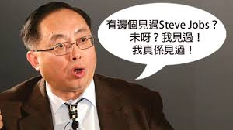
Deep Learning requires many Data
Deep Learning has seen the data, it really has seen the data
I’ve seen Steve Jobs,
I’ve really send Steve Jobs
Not human-like reasoning (cannot generalize well, NOT一理通,百理明 -> need to see many variations). It’s just a very good “mapper” (mapping input to output)
Because of that, it needs a lot of data to learn a specific task (compare this to how a people learn to cross the road)

Slide 46

Data labelling – Telsa Self Driving Car
Based on “Building the Software 2.0 Stack – by Andrej Karpathy, May 10, 2018 (page 51 – 75)

Slide 47

Data labelling Bias
Racial Bias and Gender Bias Examples in AI systems
Lawmakers Can't Ignore Facial Recognition's Bias Anymore
Cancer spotting AI image recognition is only trained on fair-skinned people. They worked more effectively on male vs. female, and on lighter vs. darker skin. The “error rates were as low as 1% on males and as high as 35% on dark females.”

Slide 48

Algorithmic Biased
Save your girlfriend or your mum first ?

Slide 49

Algorithmic Biased – Self Driving Car
Challenges
Should a self-driving car kill the baby or the grandma?
Driverless Cars Will Have to Break the Law
Responsibility: in case of breaking the law, who should go to jail (the car owner or the car company)
Less tolerant on machine than human
2019: Fanlan bus incident
2017: Taipo road incidents

Slide 50

Algorithmic Biased – Self Driving Car
Tesla
Self-Driving Car
Three years after three years, self-driving car is still not popular
你話三年。 三年之後又三年， 三年之後又三年！ 十年都嚟緊頭啦老細！
Driving or trading/investment is more difficult?

Slide 51

Deep Learning is a Black-Box
Deep learning tend to have a lot of parameters, however, it is hard to explain why the model adapt to certain weights. It’s called black-box model
I said OK is OK
Deep Learning Said OK is OK

Slide 52

Deep Learning is a Black-Box
Hard to explain the decision. Other models (decision trees) is easier to explain and interpret

Slide 53

My Thoughts on AI
Can AI replace human ?
People are (much) smarter but machines work (much much) harder. Is it a race between rabbit & tortoise -> but tortoise cannot fly (limitation of the model)
3 idiots are better than one smart guy (三個臭皮匠，勝過一個諸葛亮) vs “One vs Ten” (一個打十個)
AGI (Artificial General Intelligence): machine is not real human-like intelligence “yet” but are you going to achieve true Intelligence?

Slide 54


My Thoughts on AI
Can AI replace human ?
Biologist Emerson M. Pugh once said, “If the human brain were so simple that we could understand it, we would be so simple that we couldn’t”
Human being like to have “close touch” with human being

Slide 55
Appendix
~ Appendix Section ~

Slide 56


Summary of Machine Learning
Computer Programs
Human Programs

Slide 57

Summary of the Algorithms

Slide 58

Summary of the Usages

Slide 59

Machine Learning – Over fit / Under fit
Under fit: cannot capture the underlying trend of the data
Over fit: instead of making reliable predictions on unseen test data, it describes random error or noise. It model the underlying relationship excessively complex (too many parameters relative to the observations).The result is poor predictive performance, as it overreacts to minor fluctuations in the training data
(The key different from optimization is that Machine Learning needs to generalize the solution to predict unseen data)

Slide 60



Machine Learning – Over fit / Under fit
Accuracy | Training | Validation/Testing | Possible Solutions
Under fit | Low | Low | Increase the capacity of the model

Slide 61


Machine Learning – Over fit / Under fit
Accuracy | Training | Validation/Testing | Possible Solutions
Just fit | High | High

Slide 62


Machine Learning – Over fit / Under fit
Accuracy | Training | Validation/Testing | Possible Solutions
Over fit | High | Low | Add more data to capture enough variance or add/change the dataset features

Slide 63

Machine Learning – Over fit / Under fit
Accuracy | Training | Validation/Testing | Possible Solutions
Under fit | Low | Low | Increase the capacity of the model
Over fit | High | Low | Add more data to capture enough variance or add/change the dataset features
Just fit | High | High

Slide 64

Deep Learning vs Other Machine Learning
Deep learning tend to have a lot of parameters, hence requires sufficiently large volume of data to train and more computation power
When the data volume is less, traditional methods tend to perform better that deep-learning ones. However, when the data volume is huge, the deep-learning method wins over traditional methods. (Hence Deep Learning is more scalable)
Ref: The Number of Hidden Layers

Slide 65

Deep Learning vs Other Machine Learning
Deep Learning model can scale easily and with thousands or million parameters to model. Great power comes great responsibility…….

Slide 66








Trading Strategies - Biz
Competitor Analysis
Stock Picking
Robinhood
Brokerage
Asset Manager
Target
ETF

Slide 67

Trading Strategies – Fee Structure
2% management fee of net asset value (NAV) and 20% performance fee of fund’s profit (aka 2/20). Performance fee is subjected to a high water mark scheme. No hurdle rate (min. rate of return before collecting performance fee) is applicable.

Slide 68
Trading Strategies – Fee Structure
High-Water Mark: the highest peak in value that an fund. It prevents performance-based fees charged twice for the same amount of performance. Example: $500,000 of 20% Performance fee
First month, the fund earns a 15% return; 20% fee on this $75,000 gain, which equates to $15,000. At this point, the high-water mark $575,000
Second month, loses 20% to $460,000.
Third month, earns a profit of 50%: $460,000 to $690,000.
With a high-water mark in place, all gains from $460,000 to $575,000 are disregarded.
But gains above the high-water mark are subject to the performance-based fee. 20% on the gains from $575,000 to $690,000, which is an additional $23,000.

Slide 69
Trading Strategies - Risk Management
Maintain sustainability of the trading strategies, and to prevent catastrophic events (such as program bugs or extreme market conditions) that could cause significant loss to the portfolio. This is to guarantee that the trading strategies do not lose more than a prefixed amount or a percentage of Asset Under Management.
Strategy Stop Loss: on a per strategy basis, every time the strategy goes into a position, a stop loss order is automatically created. The strategy can only tolerate a certain amount of unrealized loss, before the position is automatically cut.
Daily Stop Loss: on an overall portfolio level, once the daily loss reaches the daily stop loss limit, the system is forbidden to establish any new positions, and any existing positions is automatically closed.

Slide 70
Trading Strategies - Workflow

Slide 71
Trading Strategies - Workflow
Raw Data: sourced from data providers (such IB, HKEx). It has to be comprehensive that covers different markets and across many years in order to learn the relationship and back test the trading strategies.
Data Processing: derive features from raw data (such as bid/ask spread and imbalance, queue size, short term money flow from the historical tick data). Pre-process the data, for instance, adjusting the price from corporation actions or holiday.
EDA (Exploratory Data Analysis): analyze/visualize (e.g. scatter plot) the data sets to summarize their main characteristics and relationships. Depends on the objective of the particular trading strategy, not all the features will be useful to feed into the machine learning models. Together with our domain knowledge on market dynamics and microstructure, we apply the EDA techniques to pick the relevant features.

Slide 72

Trading Strategies - Workflow
Feature Extraction / Clustering: feature extraction/clustering to systematically group or reduce the feature set which simplify the underlying model and ease the computation time. It will also decrease the chance of over-fitting.
This example is using Factor Analysis to group 10 different features to 3 important components. Therefore, instead of feeding 10 features to the machine learning model, we only need to use 3 components (linearly combined features) which are already captured the essential

Slide 73
Trading Strategies - Workflow
Back Testing: use historical data to evaluate the trading strategies performance, P&L and Win Ratio
Prevention of Data Snooping Bias: is a common mistake in trading strategy simulation where an algorithm makes a forecast based on information in the future, as full price history is already made available to the simulation. One way is to replay market data tick by tick into the algorithmic trading engine. The idea is to mimic real life trading, where one have no knowledge about what’s going to happen next, and would need to make decision with only data available up to this moment in time. Replay market data tick-by-tick is slow (e.g. running with one year data).
Market Impact: it is hard to model the market impact caused by your trade as it’s obviously not happened historically !

Slide 74
Trading Strategies – Supervised Learning
Challenges in Supervised Learning on trading:
Supervised learning learns a relationship (e.g. order book features to price movement) but it does not imply a policy: what if the price had moved down? Would you have sold? Kept the position and waited? What if the price had moved up just a little bit and then moved down again? What if we had been uncertain about the prediction, for example 65% up and 35% down? Would you still have bought? How do you choose the threshold to place an order?
Need a rule-based policy that takes as input your price predictions and decides what to actually do: Place an order, do nothing, cancel an order, and so on
No liquidity in the best order book levels, network latencies, and fees, none of which the supervised model could take into account.

Slide 75
Trading Strategies – Reinforcement Learning
Benefits of Reinforcement Learning on trading:
Instead of needing to hand-code a rule-based policy, Reinforcement Learning directly learns a policy (strategy).
Trained directly in Simulation Environments and able to model other agents (market participants)
Automatically determine what actions to do and what position to hold at each trading time
Reference
From Candlestick Charts to Investment Decisions
Reinforcement Learning on Trading

Slide 76


Trading Strategies – Trading Charts
Mimic human traders on analyzing charts like Candle Sticks, RSI and Moving average. Generate useful analytics such as classifying the strength of certain signals, spotting anomaly and learning the underlying patters for future predictions.

Slide 77
Trading Strategies – Trading Charts
Analysis on graphs done by artificial intelligence (AI) has the following advantages over the traditional approach of raw data
acts as a way of pre-processing from raw data as graphs can provide better summary while filtering out noises
good way to compress the data which is defined as dimension reduction, allowing “a picture is worth thousand of words”
encodes domain knowledge such as feature engineering when generating the trading graphs
mimics how human processes information by visually capturing the spatial and temporal relationships.
AI can learn more and faster

Slide 78

Trading Strategies - Trading Charts
Modules: Chart Generator, CNN (Convolutional Neural Network) and Deep-Q trading (Reinforcement Learning)
Historical Tick Data
Chart Generator
CNN
Deep-Q trading

Slide 79

Trading Strategies – Trading Charts
Chart Generator: read from raw financial data / feature set to generate trading charts.
Depends on the duration of the trend (short-term trend or long-term trend), each candle bar can a 1-min bar, 5-min, 15-min etc. and up to 1-year

Slide 80


Trading Strategies - Trading Charts
Build different modules to generate different types of charts. By inputting raw historical data such as volumes and prices into Chart Generator, it will convert the data into corresponding technical graphs such as Candle Sticks, MACD, RSI.

Slide 81

Challenges - Overfitting
In-sample training gives high accuracy (false hope) but out-sample accuracy drops significantly.
Marcos López de Prado: “Machine learning algorithms will always identify a pattern, even if there is none. The algorithms can view flukes as patterns and hence are likely to identify false strategies.

Slide 82
Limitation of Deep Learning
Everything is a vector (is a point in a geometric space). Each layer in a deep learning model operates one simple geometric transformation on the data that goes through it.
This complex transformation attempts to maps the input space to the target space, one point at a time. This transformation is parametrized by the weights of the layers, which are iteratively updated based on how well the model is currently performing.
A key characteristic of this geometric transformation is that it must be differentiable, which is required in order for us to be able to learn its parameters via gradient descent. Intuitively, this means that the geometric morphing from inputs to outputs must be smooth and continuous—a significant constraint.

Slide 83
Limitation of Deep Learning
Turning meaning into vectors, into geometric spaces, then incrementally learning complex geometric transformations that map one space to another. All you need are spaces of sufficiently high dimensionality in order to capture the full scope of the relationships found in the original data
Deep learning models do not have any understanding of their input, at least not in any human sense.
Our models can only perform local generalization, adapting to new situations that must stay very close from past data, while human cognition is capable of extreme generalization, quickly adapting to radically novel situations, or planning very for long-term future situations.

Slide 84
Roles of Humans and Machines
Short term trading: (e.g. high frequency, market making) humans already play a very small role.
Medium term investment horizon: machines are becoming increasingly relevant. It can quickly analyze news feeds and tweets, process earnings statements, scrape websites, and trade on these instantaneously. These strategies are already eroding the advantage of fundamental analysts, equity long-short managers and macro investors.
Long term horizon: machines will likely not be able to compete with strong macro and fundamental human investors (yet !?). Machines will likely not do well in assessing regime changes (market turning points) and forecasts which involve interpreting more complicated human responses such as those of politicians and central bankers, understanding client positioning, or anticipating crowding.

Slide 85

Data labelling – Telsa Self Driving Car

